Slide 1
LEVELLING

Slide 2
Levelling
It is a branch of surveying to find the elevation of points or establishing points at a given elevation with respect to given or assumed datum surface.
It is process of determining position of points in a vertical plane.

Slide 3
Classification of levelling
Simple levelling
Compound levelling
Flying levelling
Longitudinal levelling
Cross sectional levelling

Slide 4
Simple levelling
It is that type of levelling in which instrument level placed midway between the end points of a line. But in this case distance must not be very large.
2. Compound Levelling
This is also called as differential or continuous levelling. This type of levelling is done.
when the difference between the points is large.
when the difference of level between end points is large.
when there are obstacles or obstruction between the point.

Slide 5
3. Flying Levelling
In this fore sight and back sight are determined. Intermediate sight are not taken. This type of levelling is done in order to connect the starting point of the alignment of the project to the bench mark.
4. Longitudinal levelling
It is also called as profile levelling and it is performed along the centre line of the alignment of the project like railway road, highway. Longitudinal levelling is done at regular interval and regular interval is 100 to 150m.

Slide 6
5. Cross sectional levelling
It is done or conducted in direction perpendicular to the longitudinal levelling. Cross sectional levelling is done in regular interval of 10,20,30 and 50m.

Slide 7
Types of Level
• Dumpy level
• Tilting level
• Wye level
• Automatic level

Slide 8
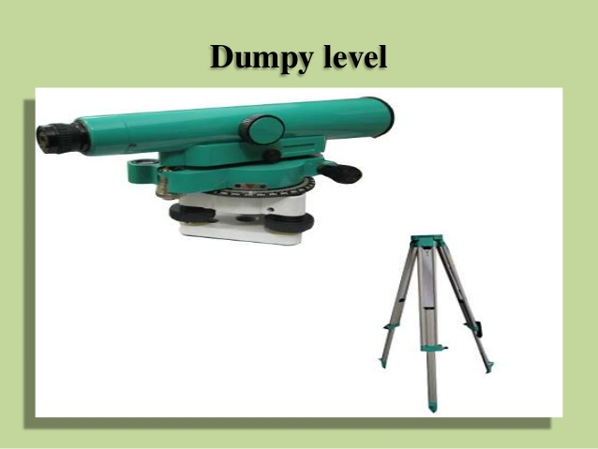
Dumpy level
• The Dumpy level is a simple, compact and stable instrument. The telescope is rigidly fixed to its supports. Hence it cannot be rotated about horizontal axis.

Slide 9
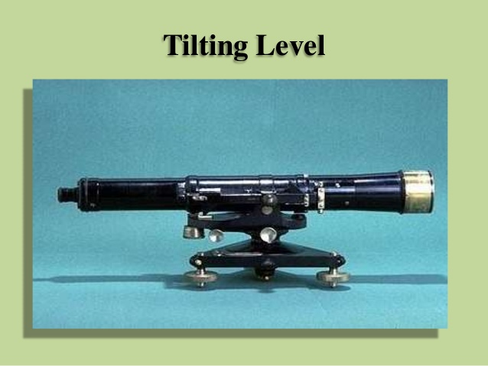
Tilting Level
• It is also known as I.O.P. level (Indian office Pattern).In this level the telescope tilts about its horizontal axis hence it is called tilting level

Slide 10
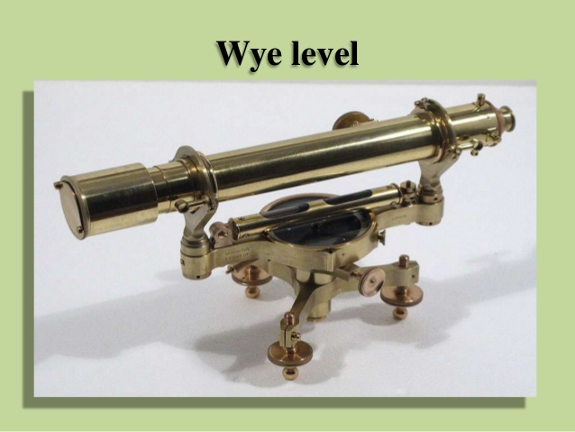
Wye level
• The essential difference between wye level and other levels is that in wye level the telescope is carried by two vertical wye supports. The telescope can be rotated, moved or even raised in wyes.

Slide 11
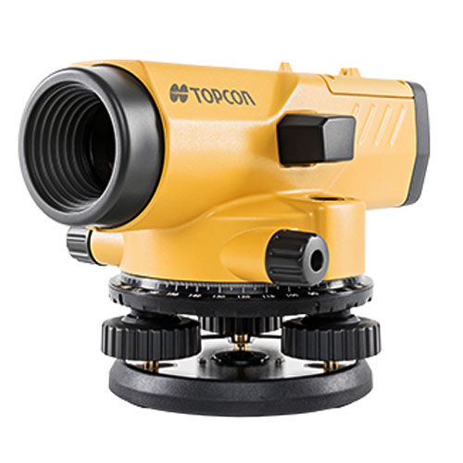
Automatic Level

Slide 12
Automatic Level
Line of collimation
It is also called as line of sight. It is an imaginary line passing through the optical centre of object glass and optical centre of eye piece.
Axis of Telescope
It is that line which is joining the optical centre of object glass to the optical centre of eye piece.

Slide 13
Back Sight Reading
It is that very first reading that is taken from the instrument level on the graduated rod or stick.
Fore Sight Reading
It is that reading which is taken at a point whose reduce level is to be determined w.r.t the back sight reading. It is the last reading taken on the staff from the same setup of level.

Slide 14
Intermediate Reading
All of the staff reading taken after back sight or fore sight.
Change Point
It is also called as turning point. It is that point where two readings are taken.

Slide 15
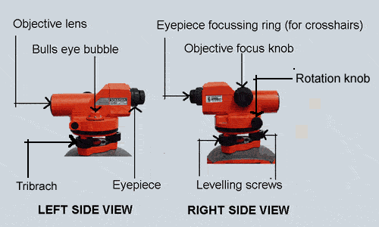
Components of Automatic Level

